Slide 1
The 4th Family Medicine Review Course
Pictures

Slide 3
When descibing a skin lesion it is important to note the following features
size
type
shape and symmetry
Color and pigmentation
surface area
distribution over the body surface

Slide 4
Morphology (types)
primary
papule, macule, nodule, plaque, pustule, vesicle, bulla, petechiae, purpura, scales.
secondary:
erosions, ulcers, excoriations, crusts, & atrophy.

Slide 5
Primary

Slide 6
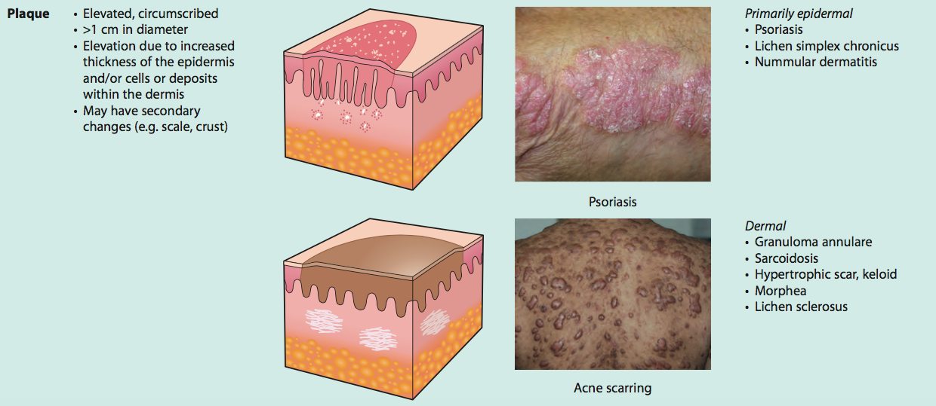

Slide 7
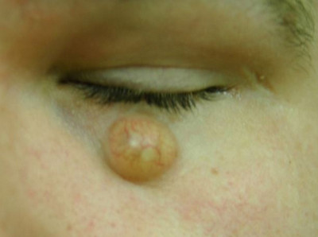

Slide 9
Secondary lesion

Slide 11
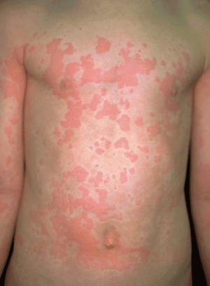
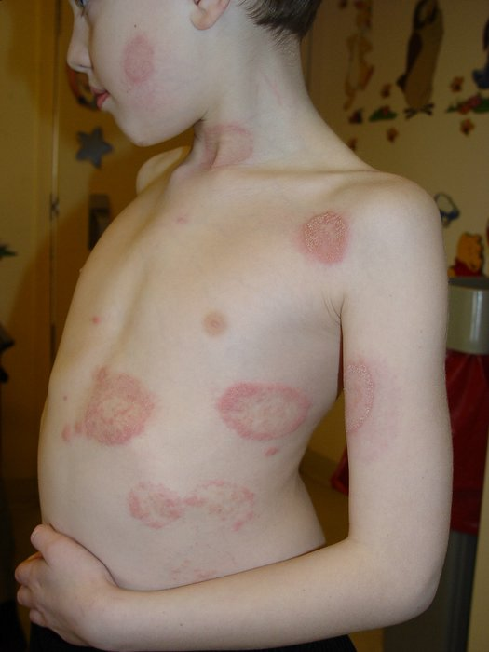
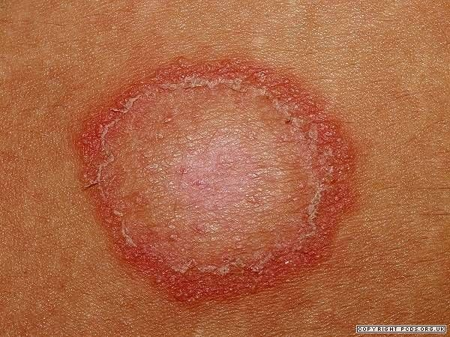
Urticaria
Tinea corporis

Slide 12
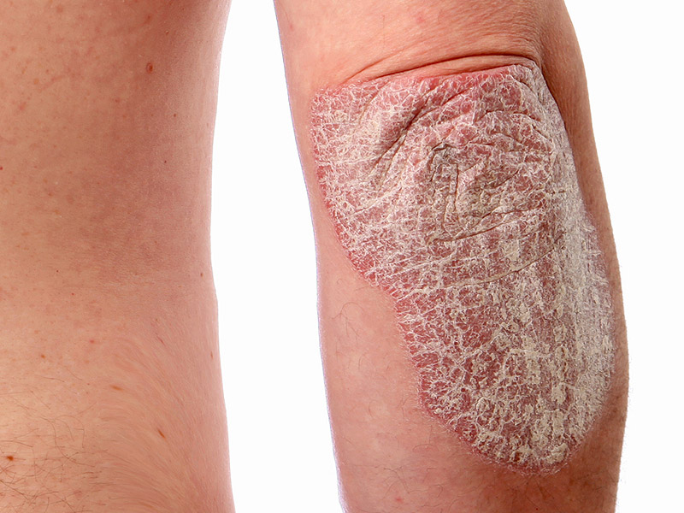
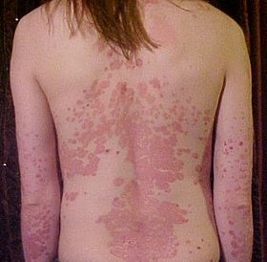
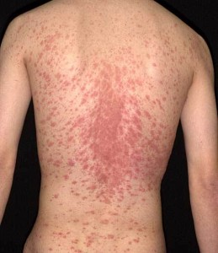
Psoriasis
Pityriasis rosea

Slide 13
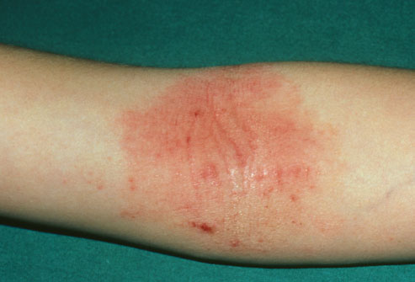
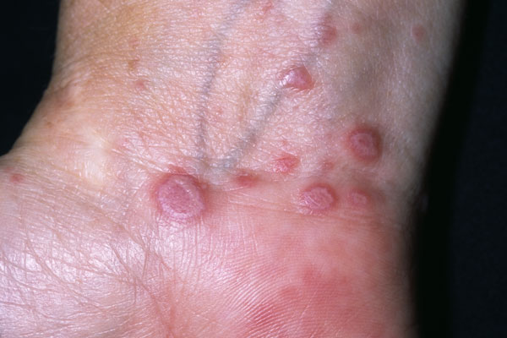
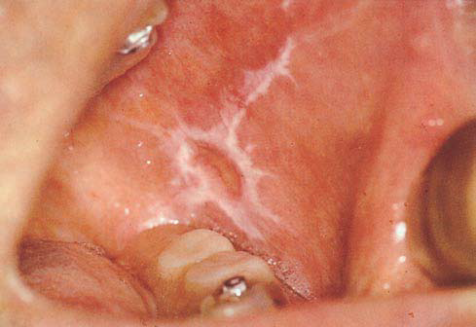
Eczema
Lichan planus

Slide 14
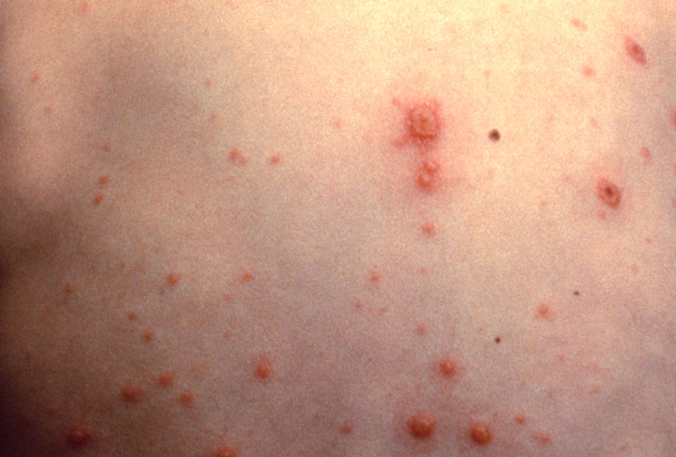
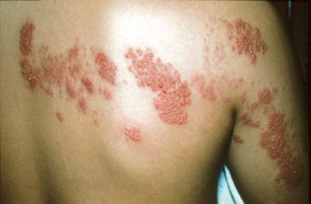
Chicken pox
Shingles

Slide 15
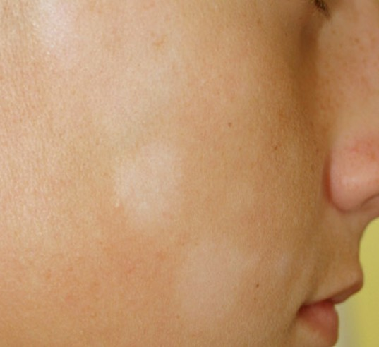
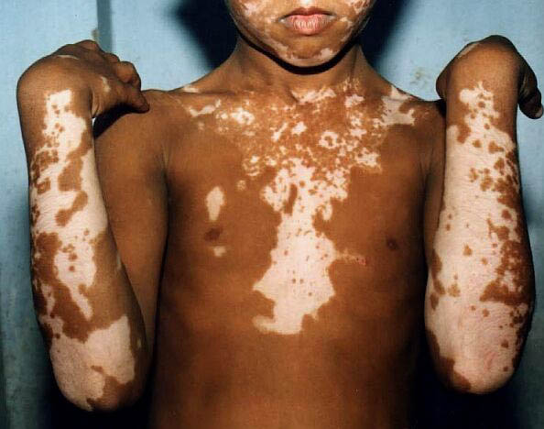
Pityriasis alba
Vitiligo

Slide 16
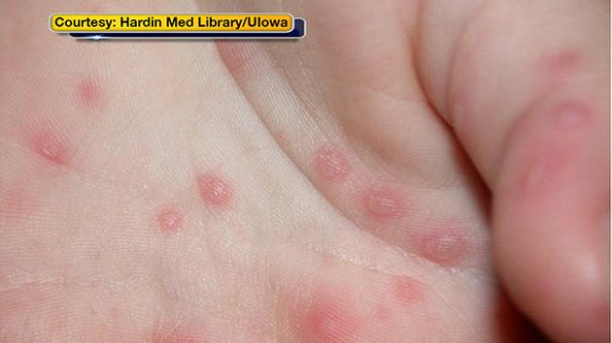
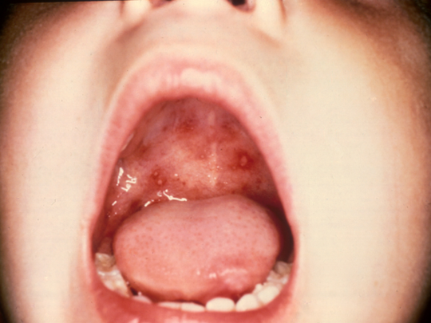
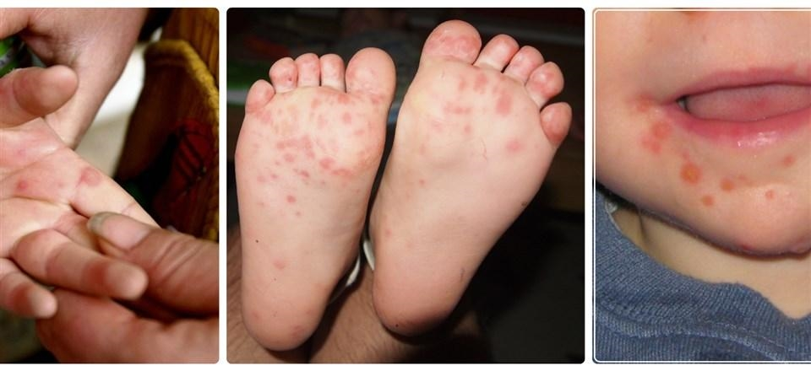

Slide 17
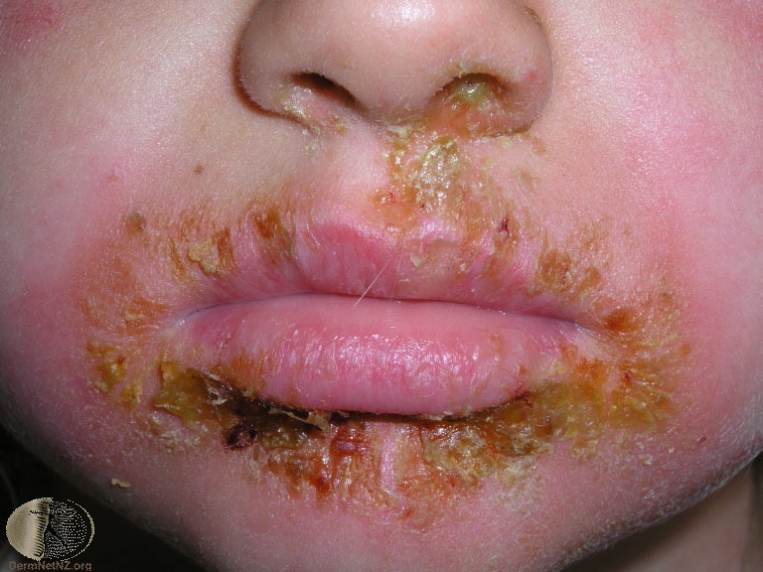
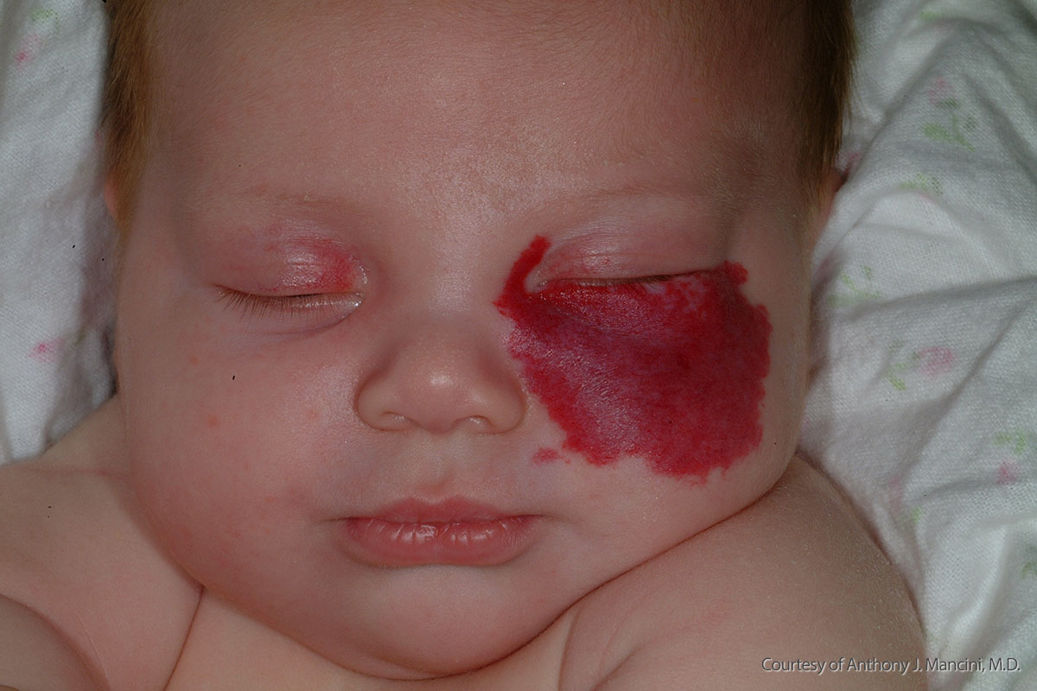
Impetigo
Hemangioma

Slide 18
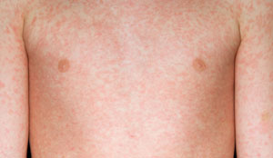
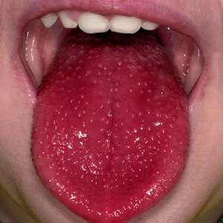
Measles
Strawberry tongue
Notes:
Same rash for rubella/// viral/// scarlet fever

Slide 19
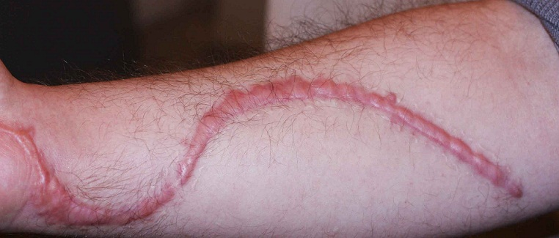
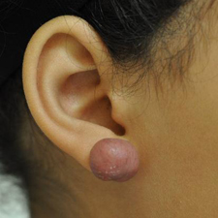
Hypertrophic scar
Keloid

Slide 20
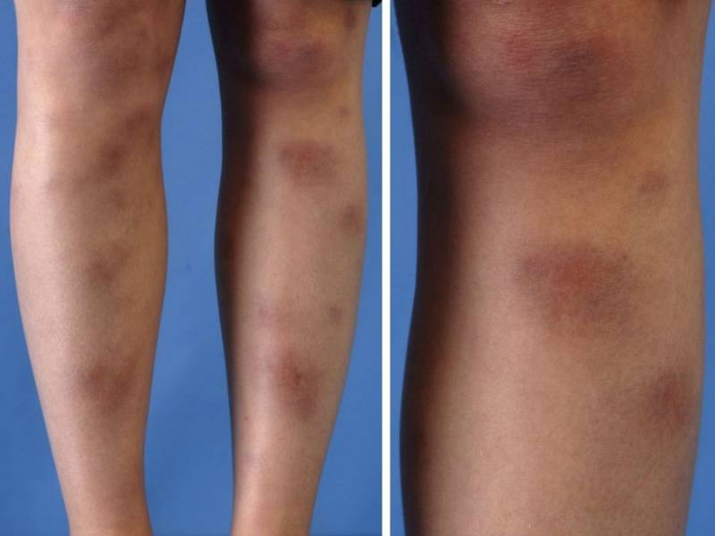
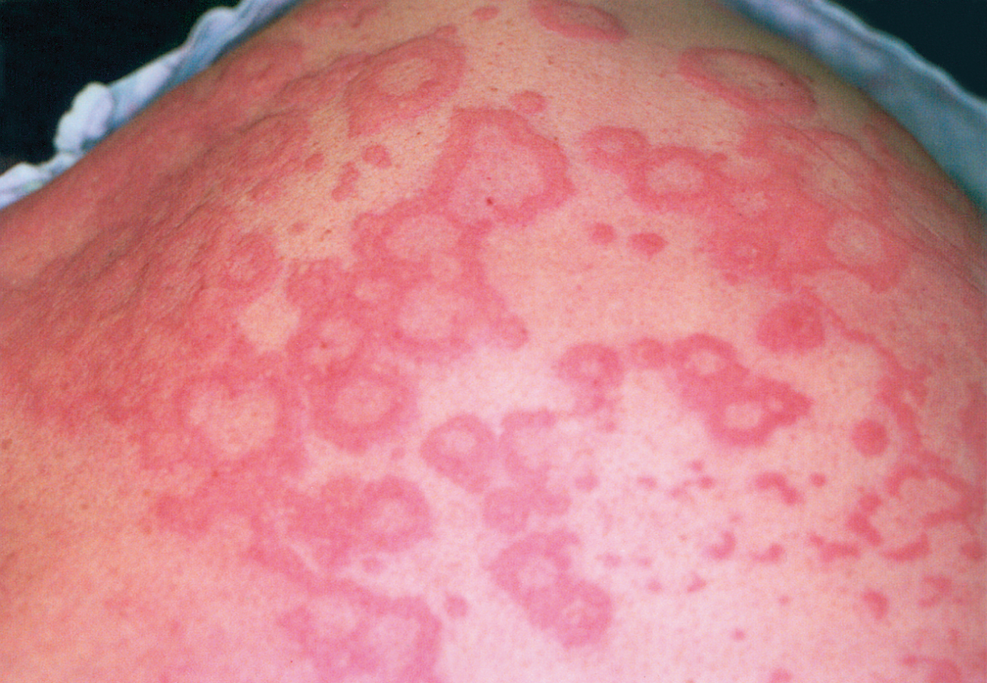
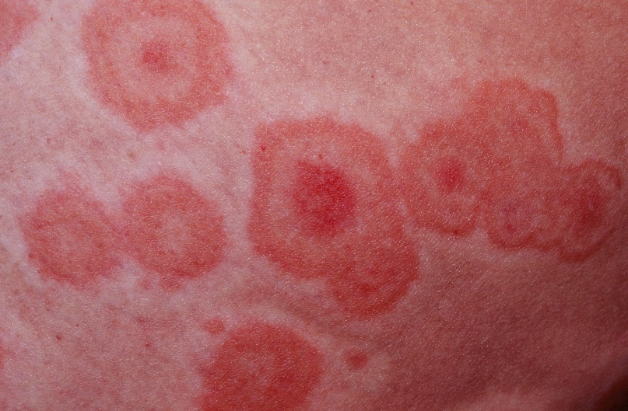
Erythema nodosum
Erythema multiforme

Slide 21
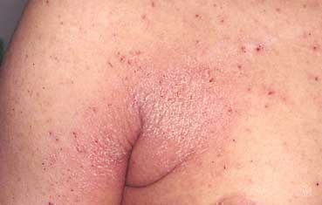
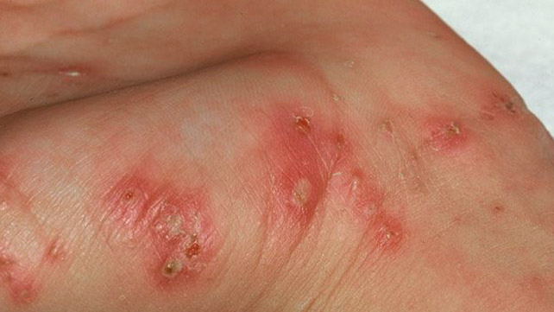
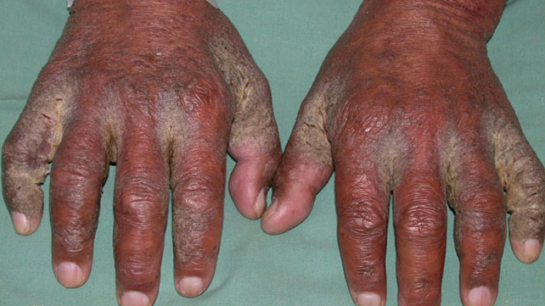
Scabies

Slide 22
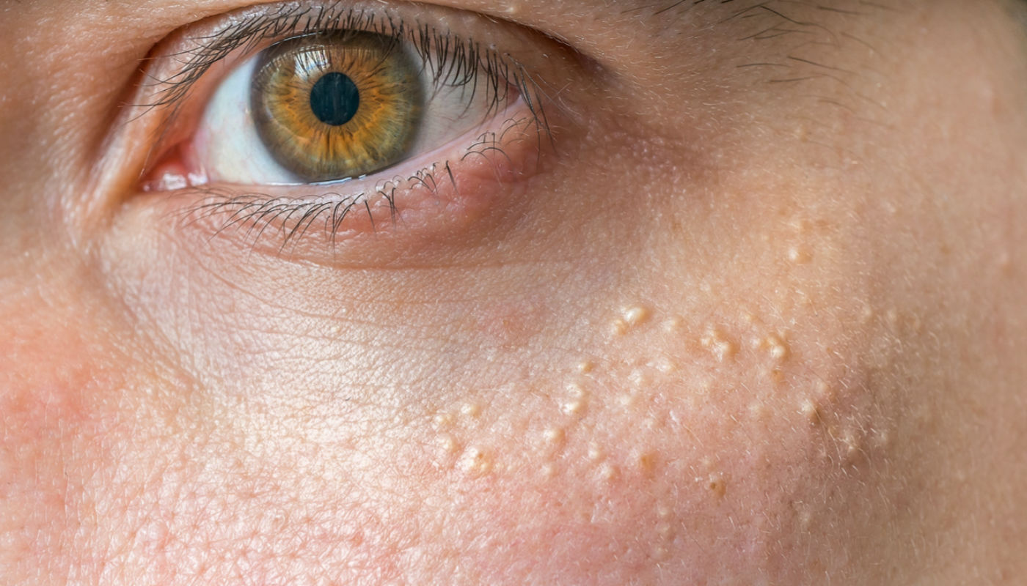
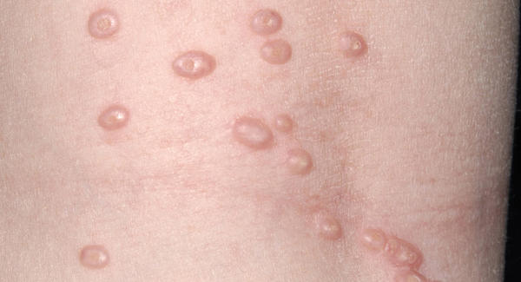
milia
Molluscum contagiosum

Slide 23
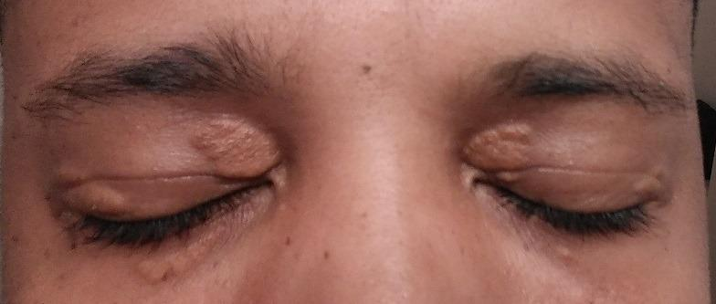
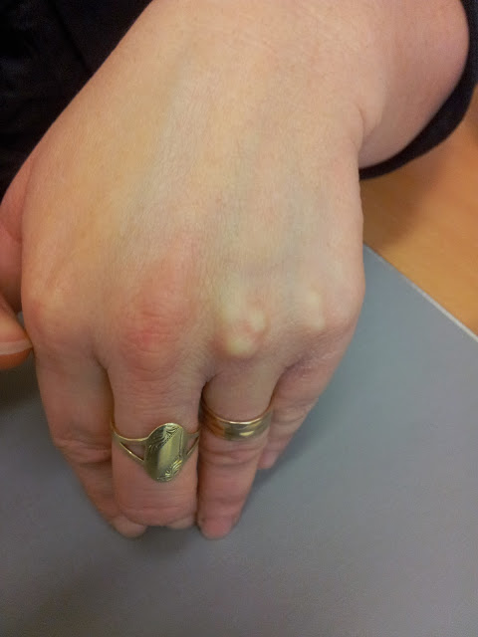
Xanthalesma
Xanthoma

Slide 24
please read the question and answer what they want only.

Slide 25
last year Exam Question
Describe what you see in the pictures ?
What is your diagnosis ?
How you manage It ?

Slide 26
Last year OSCE exam

Slide 27
Good luck in your exam

